Slide 1
YAPI STATİĞİ 2-HİPERSTATİK SİSTEMLER
DEPLASMAN METODLARI(2-2)
Prof. Dr. Cengiz Dündar

Slide 2

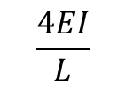
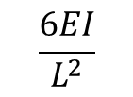
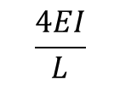
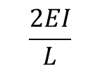
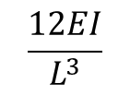
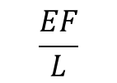
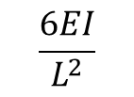
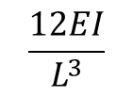
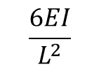
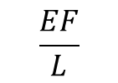
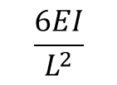
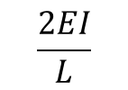
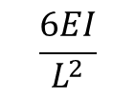
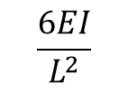
HATIRLATMA
KESİTLERİ SABİT DOĞRU EKSENLİ ÇUBUKLAR İÇİN BİRİM DEPLASMAN SABİTLERİ
$$\frac{4EI}{L}$$
$$\frac{2EI}{L}$$
i
j
$$\frac{6EI}{L^{2}}$$
A durumu
θ_{İ}=1
j
i
$$\frac{6EI}{L^{2}}$$
L
$$\frac{2EI}{L}$$
$$\frac{4EI}{L}$$
i
j
$$\frac{6EI}{L^{2}}$$
B durumu
i
j
θ_{j}=1
$$\frac{6EI}{L^{2}}$$
L
C durumu
i
$$\frac{6EI}{L^{2}}$$
$$\frac{12EI}{L^{3}}$$
δ=1
i
j
$$\frac{12EI}{L^{3}}$$
j
$$\frac{6EI}{L^{2}}$$
L
$$\frac{EF}{L}$$
$$\frac{EF}{L}$$
D durumu
i
j
Δ=1

Slide 3
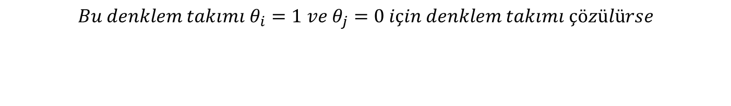


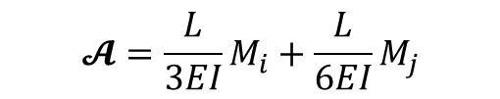

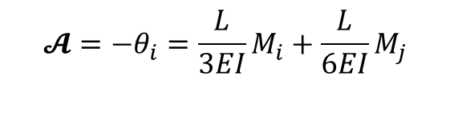


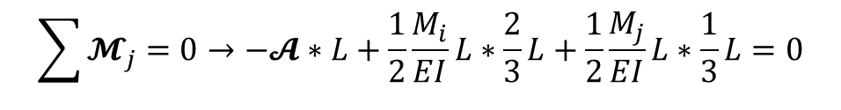
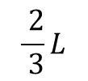

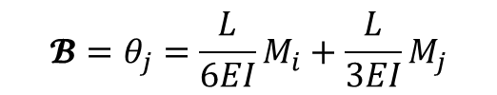
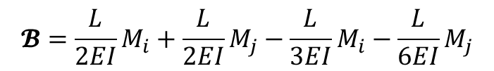

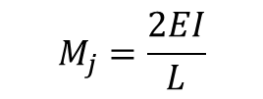

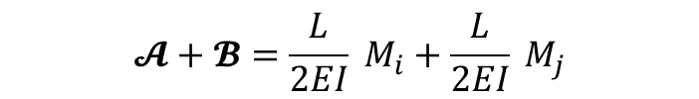
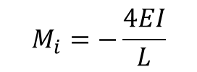

MOHR TEOREMİ İLE UÇ DÖNMELERİ HESABI (BİRİM DEPLASMAN SABİTLERİ)
HATIRLATMA
+
$$\sum{𝓜_{j}=0→−𝓐}∗L+\frac{1}{2}\frac{M_{i}}{EI}L∗\frac{2}{3}L+\frac{1}{2}\frac{M_{j}}{EI}L∗\frac{1}{3}L=0$$
$$\frac{ M_{j}}{EI}$$
$$𝓐=\frac{L}{3EI}M_{i}+\frac{L}{6EI}M_{j}$$
$$\frac{ M_{i}}{EI}$$
+
i
j
$$𝓐+𝓑=\frac{L}{2EI} M_{i}+\frac{L}{2EI} M_{j}$$
$$EI$$
$$\frac{ 1}{ 3}L$$
𝓐$={−θ}_{i}$
𝓑$=θ_{j}$
$$L$$
$$𝓑=\frac{L}{2EI}M_{i}+\frac{L}{2EI}M_{j}−\frac{L}{3EI}M_{i}−\frac{L}{6EI}M_{j}$$
$$\frac{ 2}{ 3}L$$
$$θ_{i}$$
$${𝓑=θ}_{j}=\frac{L}{6EI}M_{i}+\frac{L}{3EI}M_{j}$$
$$θ_{j}$$
$$𝓐=−θ_{i}=\frac{L}{3EI}M_{i}+\frac{L}{6EI}M_{j}$$
$$Bu denklem takımı θ_{i}=1 ve θ_{j}=0 için denklem takımı çözülürse$$
$$M_{i}=−\frac{4EI}{L}$$
$$M_{j}=\frac{2EI}{L}$$

Slide 4
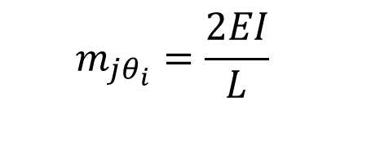
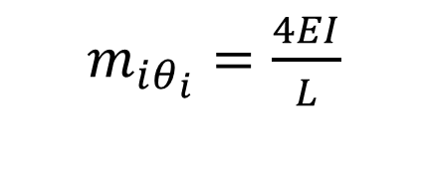
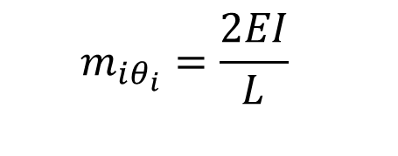
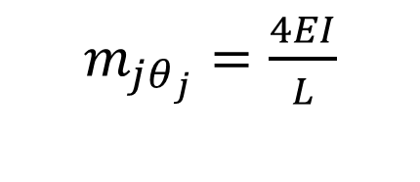
HATIRLATMA
Deplasman metotlarındaki işaretleri ile birim deplasman sabitlerini yazarsak
$m_{iθ_{i}}=\frac{4EI}{L}$
$$m_{jθ_{i}}=\frac{2EI}{L}$$
$Aynı denklem takımı θ_{i}=0 ve θ_{j}=1 için çözülürse$
$m_{jθ_{j}}=\frac{4EI}{L}$
$$m_{iθ_{i}}=\frac{2EI}{L}$$

Slide 5
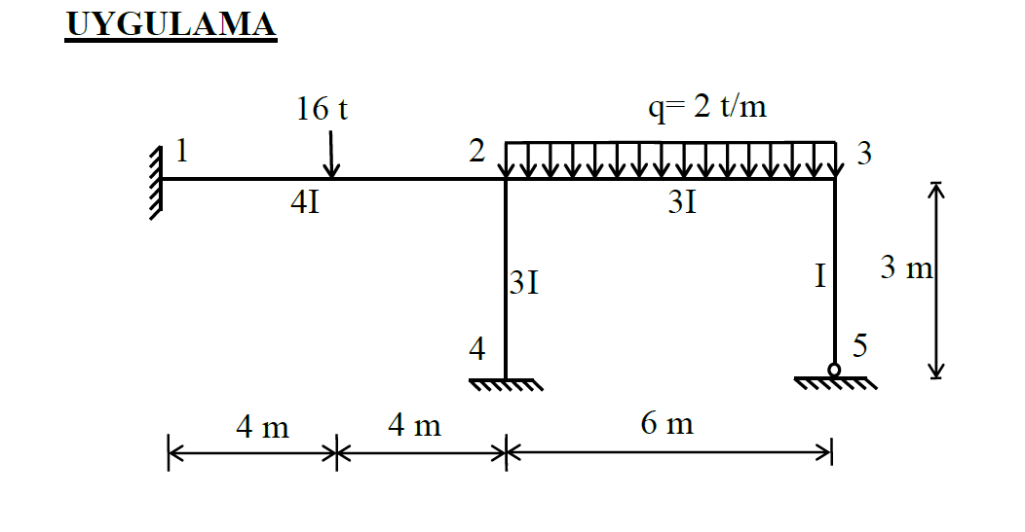

Slide 6
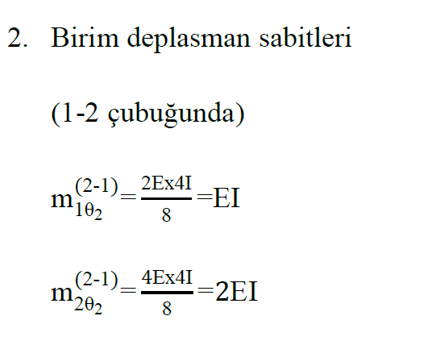
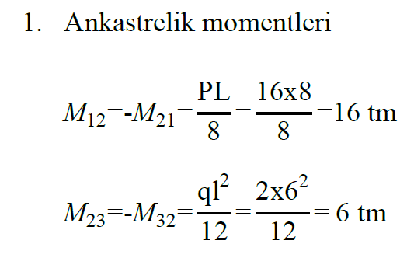
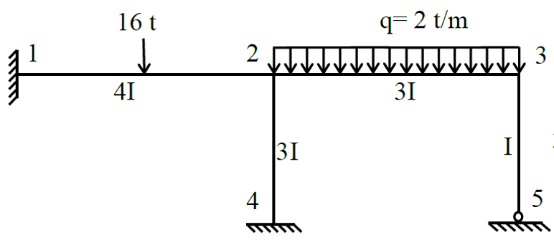

Slide 7
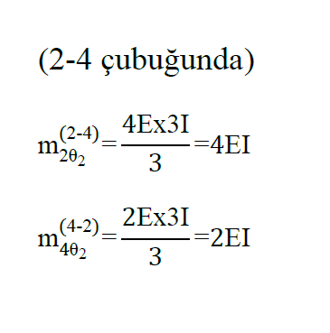
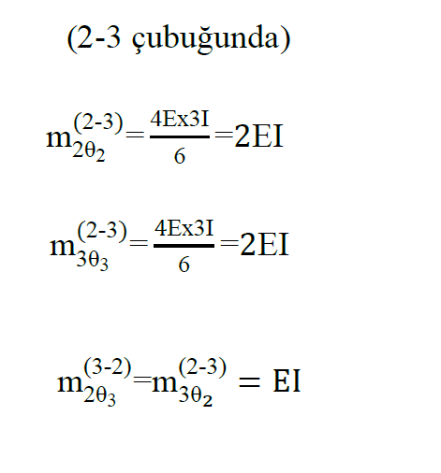
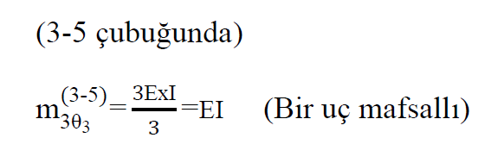

Slide 8
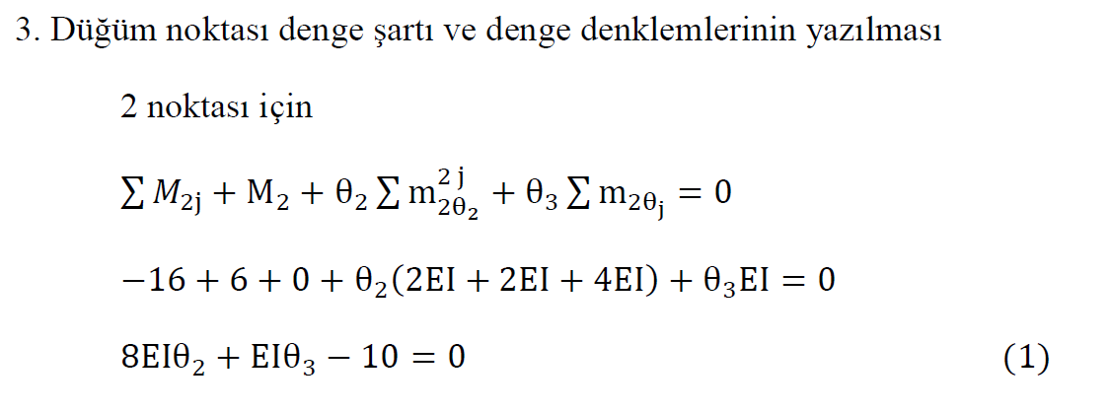

Slide 9
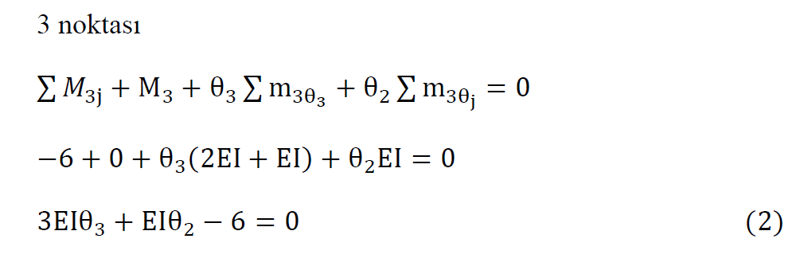
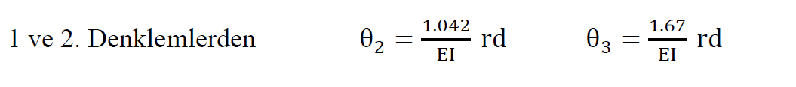

Slide 10
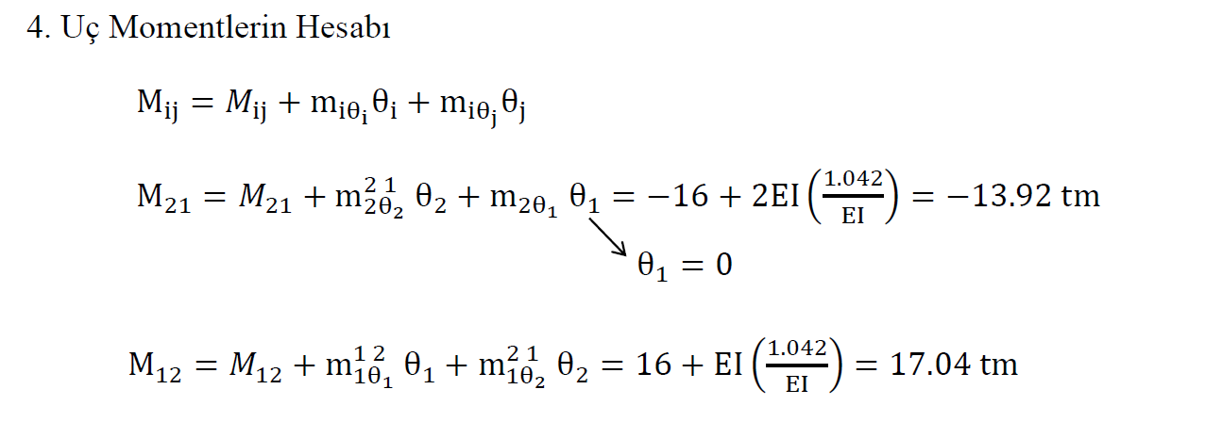

Slide 11
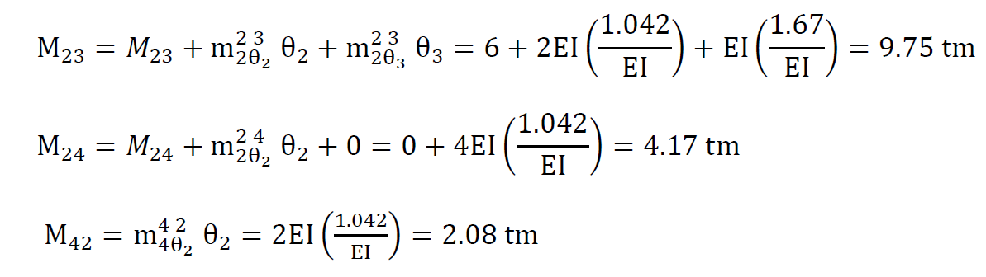
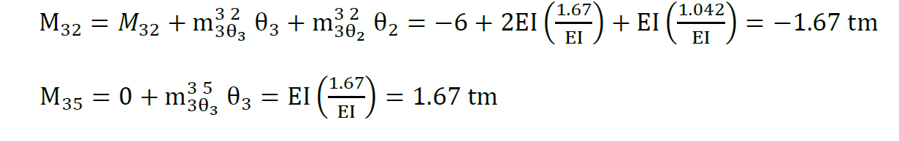

Slide 12
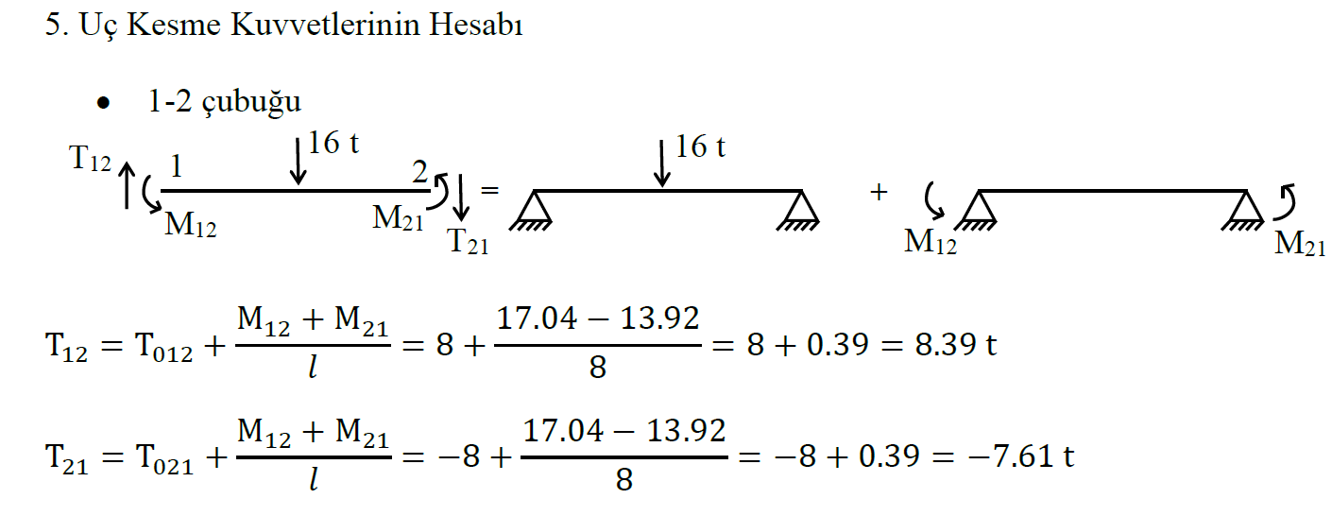

Slide 13
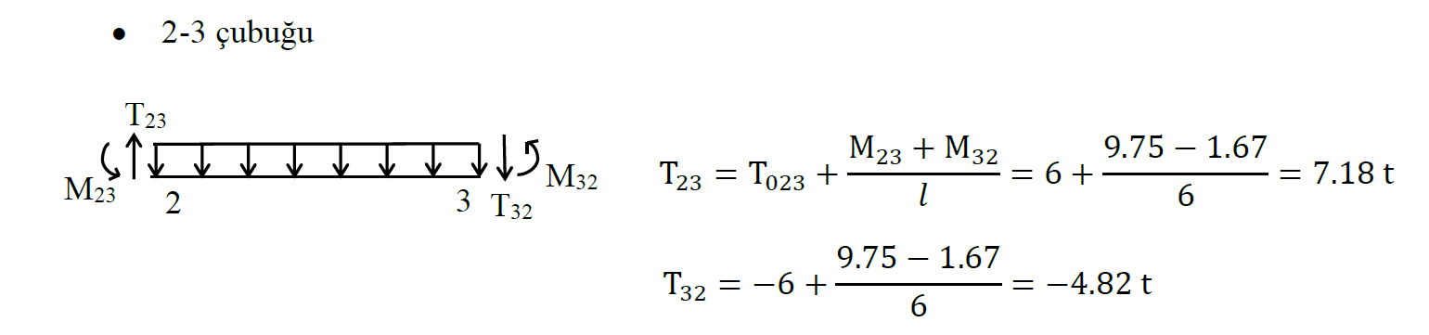
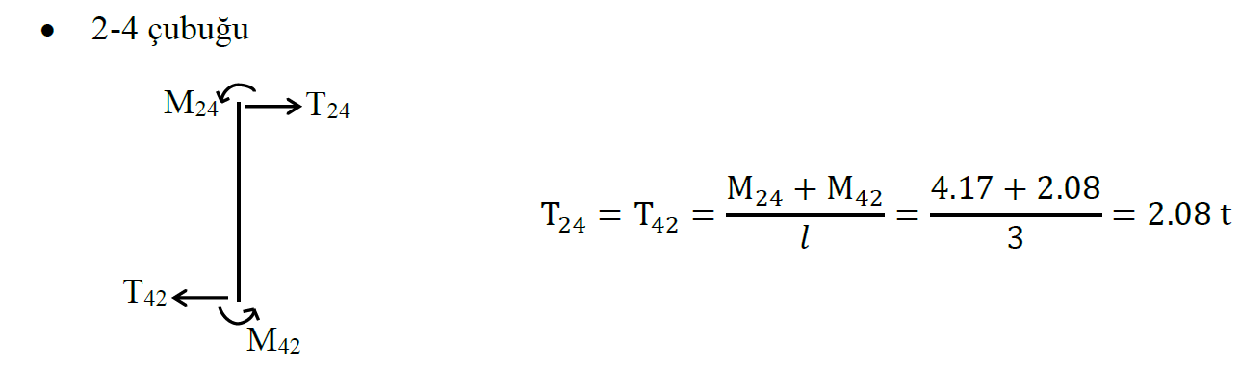

Slide 14
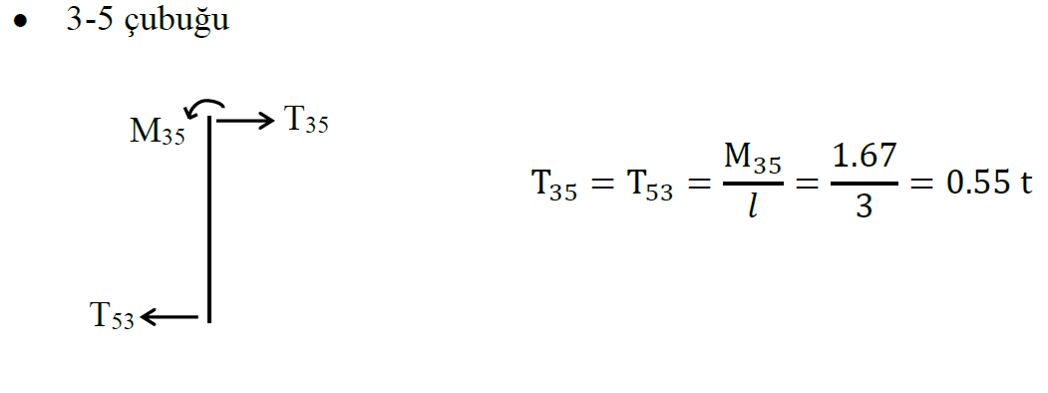

Slide 15
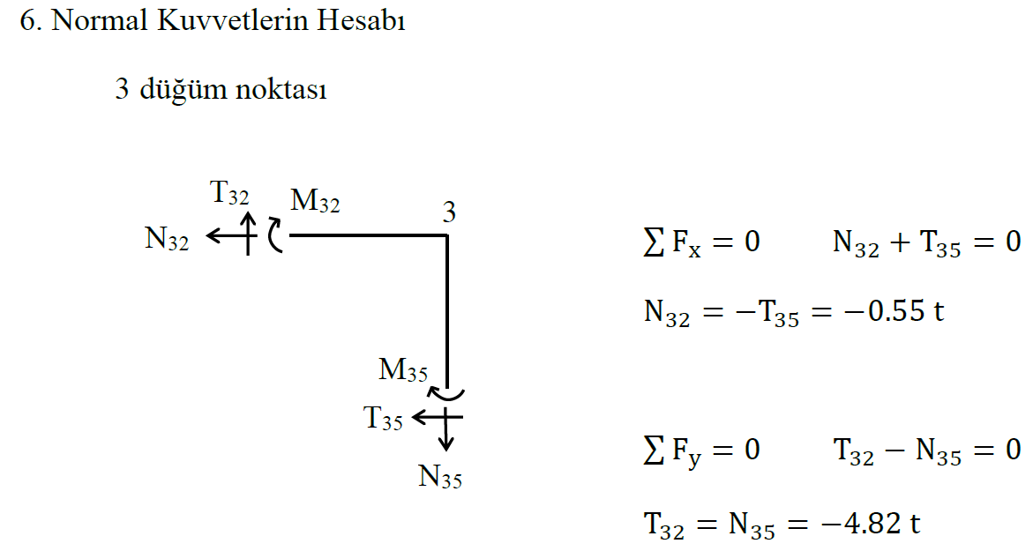

Slide 16
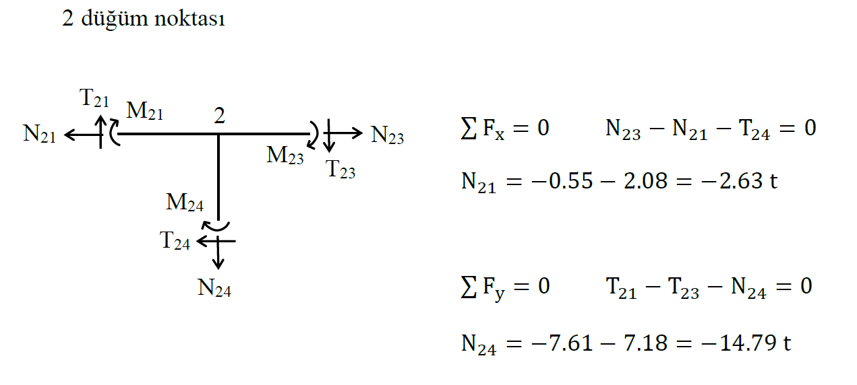

Slide 17
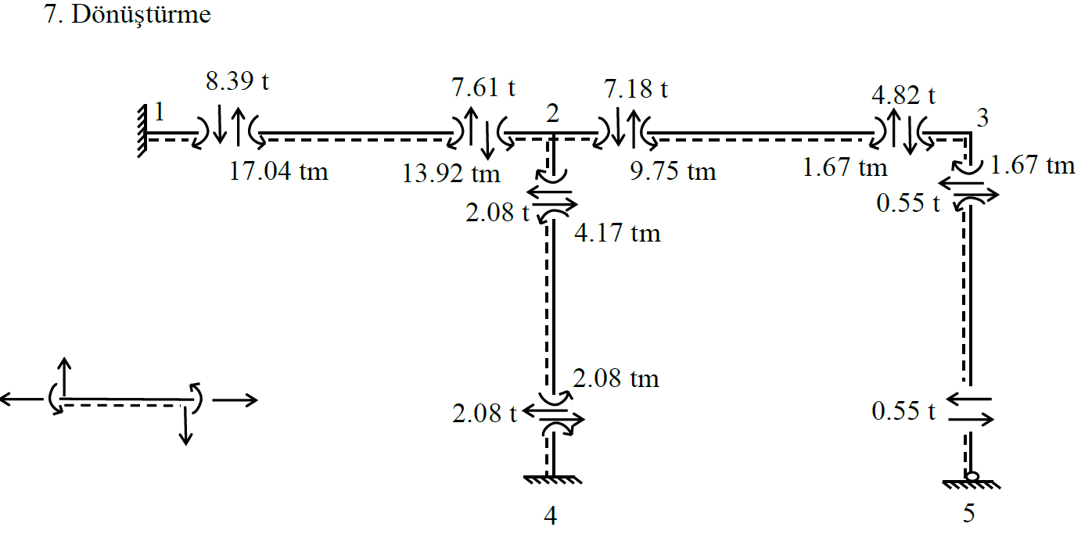
Pozitif yönler

Slide 18
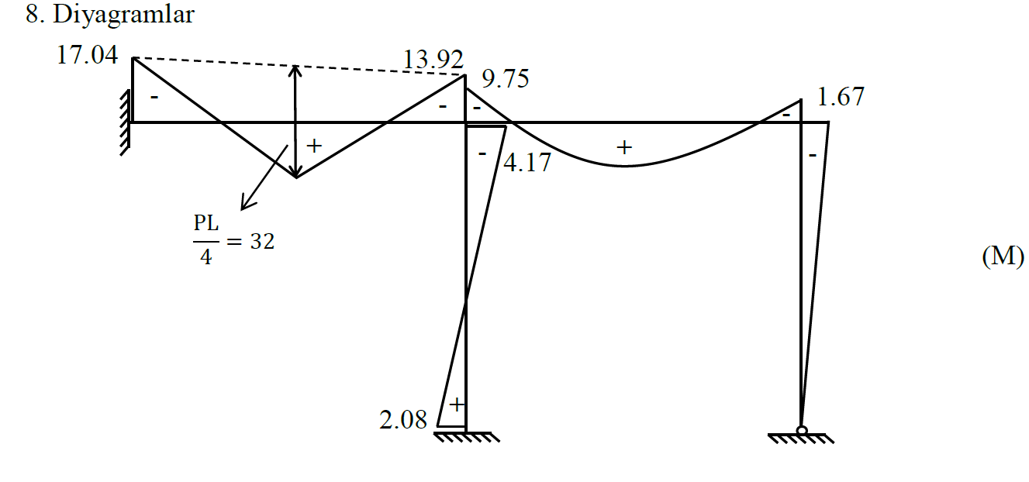

Slide 19
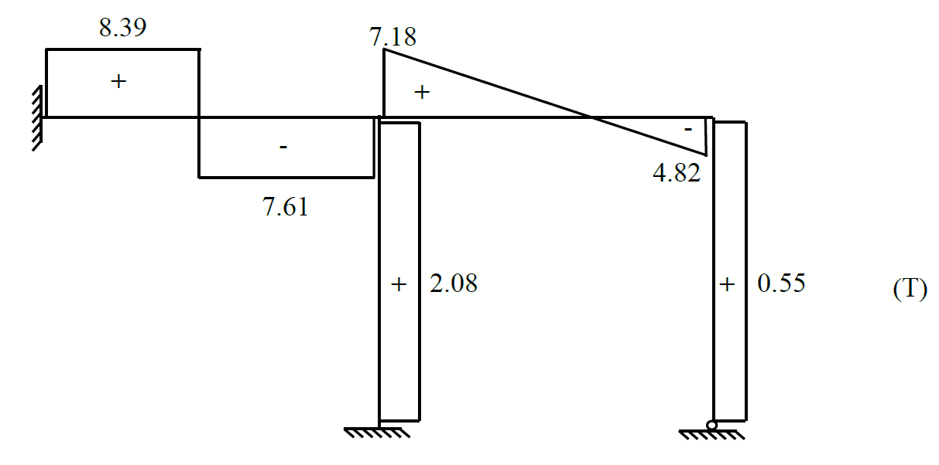

Slide 20


Slide 21





SİMETRİK VE ANTİMETRİK DEFORMASYON YAPAN SİSTEMLER
Simetri ekseni üzerinde kolon ve düğüm noktası bulunması hali
1.1 Simetrik deformasyon hali
P₁
P₁
q
j₁
j₂
i
$$θ_{j_{1}}$$
$$θ_{i}$$
$$θ_{i}$$
$$θ_{j_{2}}$$
j₃
$$M_{ij1}+M_{ij2}+M_{ij3}=0$$
$$M_{ij_{1}}=𝓜_{ij_{1}}+m_{i{θ_{i}}_{.}}^{ij_{1}}θ_{i}+m_{i{θ_{j_{1}}}_{.}}^{j_{1}i}θ_{j_{1}}$$
$$M_{ij_{2}}=𝓜_{ij_{2}}+m_{i{θ_{i}}_{.}}^{ij_{2}}θ_{i}+m_{i{θ_{j_{2}}}_{.}}^{j_{2}i}θ_{j_{2}}$$
$$M_{ij_{3}}=m_{i{θ_{i}}_{.}}^{ij_{3}}θ_{i}$$
i
M_{ij1}
M_{ij2}
M_{ij3}
$$M_{ij_{1}}+M_{ij_{2}}+M_{ij_{3}}=0=𝓜_{ij_{1}}+𝓜_{ij_{2}}+\left(m_{i{θ_{i}}_{.}}^{ij_{1}}+m_{i{θ_{i}}_{.}}^{ij_{2}}+m_{i{θ_{i}}_{.}}^{ij_{3}}\right)θ_{i}+m_{i{θ_{j_{1}}}_{.}}^{j_{1}i}θ_{j_{1}}+m_{i{θ_{j_{2}}}_{.}}^{j_{2}i}θ_{j_{2}} → θ_{i}=0 olur.$$

Slide 22


i
M_{ij1}
M_{ij2}
M_{ij3}
$$M_{ij_{1}}+M_{ij_{2}}+M_{ij_{3}}=0=𝓜_{ij_{1}}+𝓜_{ij_{2}}+\left(m_{i{θ_{i}}_{.}}^{ij_{1}}+m_{i{θ_{i}}_{.}}^{ij_{2}}+m_{i{θ_{i}}_{.}}^{ij_{3}}\right)θ_{i}+m_{i{θ_{j_{1}}}_{.}}^{j_{1}i}θ_{j_{1}}+m_{i{θ_{j_{2}}}_{.}}^{j_{2}i}θ_{j_{2}} → θ_{i}=0 olur.$$
Simetri özelliğinden
$$𝓜_{ij1}=−𝓜_{ij2}{ θ}_{j1}=−θ_{j2}$$
$$u_{i}=v_{i}=θ_{i}=0$$
P₁
q
j₁
i
Eş değer sistem

Slide 23





1.2 Antimetrik deformasyon hali
P₁
q
$$θ_{i}$$
$$θ_{j_{2}}$$
j₁
j₂
i
$$θ_{j_{1}}$$
$$θ_{i}$$
j₃
P₁
$$M_{ij_{1}}+M_{ij_{2}}+M_{ij_{3}}=0$$
$$M_{ij_{1}}=𝓜_{ij_{1}}+m_{i{θ_{i}}_{.}}^{ij_{1}}θ_{i}+m_{i{θ_{j_{1}}}_{.}}^{j_{1}i}θ_{j_{1}}$$
$$M_{ij_{2}}=𝓜_{ij_{2}}+m_{i{θ_{i}}_{.}}^{ij_{2}}θ_{i}+m_{i{θ_{j_{2}}}_{.}}^{j_{2}i}θ_{j_{2}}$$
$$M_{ij_{3}}=m_{i{θ_{i}}_{.}}^{ij_{3}}θ_{i}$$

Slide 24



$$M_{ij_{1}}+M_{ij_{2}}+M_{ij_{3}}=0={2𝓜}_{ij_{1}}+2m_{i{θ_{i}}_{.}}^{ij_{1}}θ_{i}+{2m}_{i{θ_{j_{1}}}_{.}}^{j_{1}i}θ_{j_{1}}+m_{i{θ_{i}}_{.}}^{ij_{3}}θ_{i}=0$$
$$𝓜_{ij_{1}}+m_{i{θ_{i}}_{.}}^{ij_{1}}θ_{i}+m_{i{θ_{j_{1}}}_{.}}^{j_{1}i}θ_{j_{1}}+\frac{m_{i{θ_{i}}_{.}}^{ij_{3}}}{2}θ_{i}=0$$
Antimetrik özelliğinden
$$𝓜_{ij_{1}}=𝓜_{ij_{2}}{ θ}_{j_{1}}=θ_{j_{2}}$$
P₁
q
j₁
i
$$\frac{I}{2}$$
Eş değer sistem

Slide 25



Simetri ekseni üzerinde kolon veya düğüm noktası bulunmaması hali
2.1 Simetrik deformasyon hali
P₁
q
P₁
i
j
$$θ_{i}$$
$$θ_{j}$$
_{L}
Simetri özelliğinden
$$θ_{i}={−θ}_{j}. . . . . . . . . . . . . . . . . . . . . . . . . . . . .. . .(1)$$
$$M_{ij}=𝓜_{ij}+m_{iθ_{i}}θ_{i}+m_{iθ_{j}}θ_{j} . .. . . . . . . . .\left(2\right)$$
$$M_{ij}=𝓜_{ij}+{(m}_{iθ_{i}}−m_{iθ_{j}})θ_{i} . .. . . . . . . . .\left(3\right)$$

Slide 26


Düzgün kesitli ve doğru eksenli çubuklarda
$$m_{iθ_{i}}=\frac{4EI}{L}………………(4)$$
$$m_{iθ_{j}}=\frac{2EI}{L}$$
$$M_{ij}=𝓜_{ij}+(\frac{4EI}{L}−\frac{2EI}{L})θ_{i}$$
$$M_{ij}=𝓜_{ij}+\frac{2EI}{L}θ_{i}$$
İ j çubuğuna ait birim deplasman sabiti =
$$\frac{2EI}{L} olarak alınır$$
_{L/2}

Slide 27



2.2 Antimetrik deformasyon hali
P₁
P₁
i
j
$$θ_{i}$$
$$θ_{j}$$
P₁
P₁
_{L}
Antimetrik özelliğinden
$$θ_{i}=θ_{j}. . . . . . . . . . . . . . ….. . . . . . . . . . . . . . .. . .(1)$$
$$M_{ij}=𝓜_{ij}+m_{iθ_{i}}θ_{i}+m_{iθ_{j}}θ_{j} . .. . . . . . . . .\left(2\right)$$
$$M_{ij}=𝓜_{ij}+{(m}_{iθ_{i}}+m_{iθ_{j}})θ_{i} . .. . . … . . . . .\left(3\right)$$

Slide 28


Düzgün kesitli ve doğru eksenli çubuklarda
$$m_{iθ_{i}}=\frac{4EI}{L}$$
$$m_{iθ_{j}}=\frac{2EI}{L}$$
$$M_{ij}=𝓜_{ij}+(\frac{4EI}{L}+\frac{2EI}{L})θ_{i}$$
$$M_{ij}=𝓜_{ij}+\frac{6EI}{L}θ_{i}$$
İ j çubuğuna ait birim deplasman sabiti =
$$m_{iθ_{i}}=\frac{6EI}{L} olarak alınır$$
_{L/2}

Slide 29


GELİŞİ GÜZEL YÜKLÜ SİMETRİK SİSTEMLER
P₁ =4 t
q
P₂ =1 t
P’₁ =2.5 t
P’₁ =2.5 t
P’₂ =1.5 t
q
q
=
+
P’₂ =1.5 t
$$P_{1}^{′}+P_{2}^{′}=P_{1}$$
$$P_{1}^{′}−P_{2}^{′}=P_{2 }$$
$$P_{1}^{′}=\frac{P_{1}+P_{2}}{2}{ P}_{2}^{′}=\frac{P_{1}−P_{2}}{2}$$

Slide 30


Herhangi bir noktadaki dönme açısının tayini
₁
₂
₃
$$M_{ij}=𝓜_{ij}+m_{iθ_{i}}θ_{i}+m_{iθ_{j}}θ_{j}$$
$$M_{21}=𝓜_{21}+m_{2θ_{2}}^{21}θ_{2}+0$$
$$M_{21} belli iken θ_{2}=\frac{M_{21}−𝓜_{21}}{m_{2θ_{2}}^{21}}$$
₄
$$M_{42}=𝓜_{42}+m_{4θ_{4}}^{42}θ_{4}+m_{4θ_{2}}^{24}θ_{2}$$
$$𝓜_{42}=0 iken θ_{4}=−\frac{m_{4θ_{2}}^{24}}{m_{4θ_{4}}^{42}}θ_{2}=−\frac{\frac{2EI}{L}}{\frac{4EI}{L}}θ_{2}=−\frac{1}{2}θ_{2} θ_{4}=−\frac{1}{2}θ_{2}$$

Slide 31






UYGULAMA
$$m_{2θ_{2}}^{21}=\frac{4E3I}{12}$$
q=2 t/m
₁
₂
₃
$$m_{2θ_{2}}^{25}=\frac{4EI}{4}$$
_{3I}
_{3I}
_{3I}
_{I}
_{I}
_{4 m}
Simetri özelliğinden
₅
₄
$$m_{2θ_{2}}^{23}=\frac{2E3I}{12}$$
_{12 m}
_{12 m}
_{12 m}
$$2 düğüm noktası denge denklemi$$
$$\sum{𝓜_{2J}+θ_{2}\sum{m_{2θ_{2}}^{2j}=0}}$$
$$\frac{2∗{12}^{2}}{12}+\left(\frac{4E3I}{12}+\frac{4EI}{4}+\frac{2E3I}{12}\right)θ_{2}=0$$
$$θ_{2}=−\frac{24}{2.5EI}radyan{ θ}_{3}=−θ_{2}=\frac{24}{2.5EI}rd$$
Simetri özelliğinden
Ankastrelik Momentleri
$$𝓜_{23}=−𝓜_{32}=\frac{qL^{2}}{12}=\frac{2∗{12}^{2}}{12}=24 tm$$

Slide 32





Çubuk uç momentleri
$$M_{23}=𝓜_{23}+m_{2θ_{2}}^{23}θ_{2}$$
$$M_{23}=24+\frac{2E3I}{12}\left(−\frac{24}{2.5EI}\right)=19.2 tm$$
$$M_{21}=𝓜_{21}+m_{2θ_{2}}^{21}θ_{2}=0+\frac{4E3I}{12}\left(−\frac{24}{2.5EI}\right)=−9.6 tm$$
$$M_{25}=m_{2θ_{2}}^{25}θ_{2}=\frac{4EI}{4}\left(−\frac{24}{2.5EI}\right)=−9.6 tm$$
$$M_{12}=m_{1θ_{2}}^{12}θ_{2}=\frac{2E3I}{12}\left(−\frac{24}{2.5EI}\right)=−4.8 tm$$
$$M_{52}=m_{5θ_{2}}^{52}θ_{2}=\frac{2EI}{4}\left(−\frac{24}{2.5EI}\right)=−4.8 tm$$
Simetri özelliğinden
$$m_{2θ_{2}}^{21}=\frac{4E3I}{12}$$
$$m_{2θ_{2}}^{25}=\frac{4EI}{4}$$
Simetri özelliğinden
$$m_{2θ_{2}}^{23}=\frac{2E3I}{12}$$

Slide 33







Dönüştürme:
4.8
9.6
19.2
9.6
Moment diyagramı
4.8
$$\frac{qL^{2}}{8}=\frac{2∗{12}^{2}}{8}=36$$
19.2
19.2
9.6
9.6
₁
-
-
-
-
₂
₃
+
9.6
-
+
9.6
+
4.8
-
4.8
+
₄
₅
4.8
+
4.8
$$M_{max}=36−19.2=16.4 tm$$

Slide 34










Kesme kuvvetleri hesabı
4.8
9.6
$$T_{12}=T_{21}=0+\frac{−4.8−9.6}{12}=−1.2 t$$
$$T_{12}=1.2 t$$
$$T_{21}=1.2 t$$
19.2
19.2
$$T_{23}=12+\frac{19.2−19..2}{12}=12 t$$
$$T_{32}=12 t$$
$$T_{32}=−12+\frac{19.2−19..2}{12}=−12 t$$
$$T_{23}=12 t$$
9.6
$$T_{25}=3.6$$
$$T_{25}=T_{52}=0+\frac{−9.6−4.8}{4}=−3.6 t$$
$$T_{52}=3.6$$
4.8

Slide 35




Kesme kuvveti diyagramı
$$T_{23}=12 t$$
$$T_{34}=1.2 t$$
+
₃
+
₁
-
₂
-
-
+
_{4 m}
$$T_{12}=1.2 t$$
₅
$$T_{32}=−12 t$$
₄
$$T_{52}=3.6$$
_{12 m}
_{12 m}
_{12 m}

Slide 36

ÖZEL HALLER
Konsollu sistemler
1.1 Konsollu çerçeveler
P₁
P₂
P₂
q
q
M₁ (-)
q
₂
M₄ (+)
₃
₄
₂
₃
₄
₁
₅
₁
₅
$$\sum{M_{2}=0 }\sum{𝓜_{2j}}+\left(−M_{1}\right)+\sum{m_{2{θ_{2}}_{}}^{2j}}θ_{2}+\sum{m_{2{θ_{j}}_{.}}^{}}θ_{j}=0$$
$$\sum{M_{4}=0 }\sum{𝓜_{4j}}+\left(+M_{4}\right)+\sum{m_{4{θ_{4}}_{}}^{4j}}θ_{4}+\sum{m_{4{θ_{j}}_{.}}^{}}θ_{j}=0$$
Düğüm noktalarına gelen momentler saat akrebi yönünde pozitiftir.

Slide 37


UYGULAMA
2 t
q=1 t/m
₄
_{3 m}
₃
_{3I}
q=2 t/m
_{II}
_{3 m}
₁
_{4I}
₂
_{2I}
_{3 m}
₅
_{9 m}
_{9 m}
Açı metodunu kullanarak M N T diyagramlarını çiziniz.
q
q
i
j
i
j
$$𝓜_{ij}=−𝓜_{ji}=\frac{qL^{2}}{12}$$
$$𝓜_{ij}=\frac{qL^{2}}{8}$$

Slide 38





Ankastrelik momentleri:
$$𝓜_{12}=−𝓜_{21}=\frac{qL^{2}}{12}=\frac{2∗9^{2}}{12}=13.50 tm$$
$$𝓜_{34}=\frac{qL^{2}}{8}=\frac{1∗9^{2}}{8}=10.12 tm$$
Birim deplasman sabitleri:
$$M_{konsol}=−(2∗3+1∗3∗\frac{3}{2})=−10.5 tm$$
$$1−2 çubuğu$$
$$m_{1θ_{1}}^{12}=\frac{4E4I}{9}=1.78EI{ m}_{1θ_{2}}^{12}=\frac{2E4I}{9}=0.89EI$$
$${m_{1θ_{1}}^{12}=m}_{2θ_{2}}^{21}=\frac{4E4I}{9}=1.78EI$$
$${m_{2θ_{1}}^{21}=m}_{1θ_{2}}^{12}$$
$$2−5 çubuğu$$
$$m_{2θ_{2}}^{25}=\frac{3E2I}{3}=2EI$$

Slide 39

$$2−3 çubuğu$$
$$m_{2θ_{2}}^{23}=m_{3θ_{3}}^{32}=\frac{4EI}{3}=1.33EI$$
$$m_{3θ_{2}}^{32}=\frac{2EI}{3}=0.667EI$$
$$m_{2θ_{3}}^{23}=\frac{2EI}{3}=0.667EI$$
$$3−4 çubuğu$$
$$m_{3θ_{3}}^{34}=\frac{3E3I}{9}=EI{ m}_{4θ_{3}}^{34}=0$$

Slide 40














Denge denklemleri:
$$M_{21}=𝓜_{21}+m_{2θ_{2}}^{21}θ_{2}$$
$$M_{23}=0+m_{2θ_{2}}^{23}θ_{2}+m_{2θ_{3}}^{23}θ_{3}$$
$${ M}_{25}=0+m_{2θ_{2}}^{25}θ_{2}$$
$$M_{21}$$
$$M_{23}$$
$$2$$
$$M_{25}$$
$$0=𝓜_{21}+\left(m_{2θ_{2}}^{21}+m_{2θ_{2}}^{23}+m_{2θ_{2}}^{25}\right)θ_{2}+m_{2θ_{3}}^{23}θ_{3}………………..(1)$$
$$−13.5+\left(1.78EI+1.33EI+2EI\right)θ_{2}+0.67EIθ_{3}=0$$
$$M_{32}=0+m_{3θ_{3}}^{32}θ_{3}+m_{3θ_{2}}^{32}θ_{2}$$
$$M_{34}=𝓜_{34}+m_{3θ_{3}}^{34}θ_{3}$$
$${ M}_{konsol}=−10.5 tm$$
1 ve 2 den
$$θ_{2}=\frac{2.73}{EI}rd$$
$$θ_{3}=−\frac{0.61}{EI}rd$$
$$M_{konsol}=−10.5 tm$$
$$3$$
$$M_{34}$$
$$M_{32}$$
$$0=𝓜_{34}+{ M}_{konsol}+\left(m_{3θ_{3}}^{32}+m_{3θ_{3}}^{34}\right)θ_{3}+m_{3θ_{2}}^{32}θ_{2}……..……………(2)$$
$$10.12−10.5+\left(1.33EI+1.00EI\right)θ_{3}+0.67EIθ_{2}=0$$

Slide 41






Çubuk uç momentleri:
$$M_{12}=𝓜_{12}+m_{1θ_{1}}^{12}θ_{1}+m_{1θ_{2}}^{12}θ_{2}$$
$$M_{12}=13.5+0+0.89EI\left(\frac{2.73}{EI}\right)=15.92 tm$$
$$M_{21}=−13.50+1.78EI\left(\frac{2.73}{EI}\right)+0=−8.65 tm$$
$$M_{23}=0+1.33EI\left(\frac{2.73}{EI}\right)+0.67EI\left(−\frac{0.61}{EI}\right)=3.21 tm$$
$$M_{32}=0+1.33EI\left(−\frac{0.61}{EI}\right)+0.67EI\left(\frac{2.73}{EI}\right)=1.00 tm$$
$$M_{25}=0+2EI\left(\frac{2.73}{EI}\right)=5.44 tm$$
$$M_{34}=10.12+EI\left(−\frac{0.61}{5EI}\right)=9.5 tm$$
$${ m}_{1θ_{2}}^{12}=\frac{2E4I}{9}=0.89EI$$
$${m_{1θ_{1}}^{12}=m}_{2θ_{2}}^{21}=\frac{4E4I}{9}=1.78EI$$
$$m_{2θ_{2}}^{23}=m_{3θ_{3}}^{32}=\frac{4EI}{3}=1.33EI$$
$$m_{2θ_{2}}^{25}=\frac{3E2I}{3}=2EI$$
$$m_{3θ_{3}}^{34}=\frac{3E3I}{9}=EI{ m}_{4θ_{3}}^{34}=0$$

Slide 42


















Dönüştürme:
$$M_{konsol}=−10.5 tm$$
$$T_{34}=5.56$$
$$T_{43}=3.44$$
10.5
9.5
9.5
$$T_{konsol}=5 t$$
1.0
$$T_{32}=1.41$$
1.0
3.21
$$T_{23}=1.41$$
15.92
15.92
3.21
8.65
8.65
$$T_{12}=9.81$$
$$T_{21}=8.19$$
5.44
$$T_{25}=1.81$$
5.44
$$T_{52}=1.81$$

Slide 43

kesme kuvvetleri hesabı:
$$T_{12}=T_{012}+\frac{M_{12}+M_{21}}{L}$$
$$T_{12}=9+\frac{15.92−8.65}{9}=9.81 t T_{21}=−9+\frac{15.92−8.65}{9}=−8.19 t$$
$$T_{23}=T_{32}=\frac{M_{23}+M_{32}}{L}=\frac{3.21+1.00}{3}=1.41 t T_{34}=4.5+\frac{9.5}{9}=5.56 t{ T}_{43}=−4.5+\frac{9.5}{9}=−3.44 t$$
$$T_{25}=T_{52}=\frac{M_{25}}{L}=\frac{5.44}{3}=1.81 t$$
$$T_{konsol}=2+1∗3=5 t$$

Slide 44




Normal kuvvetlerin hesabı:
3. Düğüm noktası $\sum{y}=0 → N_{32}=−10.56 t \sum{x=0{ N}_{34}=1.41 t}$
$$T_{konsol}=5 t$$
3
N₃₄
10.56 t
5.56 t
1.41 t
1.41 t
N₂₁
2
2 Düğüm noktası
N₃₂
8.19 t
1.81 t
N₂₅
$$\sum{x}=0 → N_{21}=−1.81+1.41=−0.4 t \sum{y=0{ −N}_{25}−10.56−8.19=−18. 75t}$$

Slide 45


Moment diyagramı
10.5
$$\frac{qL^{2}}{8}=\frac{1∗9^{2}}{8}=10.125$$
9.5
15.92
-
$$\frac{qL^{2}}{8}=\frac{2∗9^{2}}{8}=20.25$$
+
1.0
+
8.65
_{4 m}
-
-
5.44
+
3.21
-
_{4 m}
_{9 m}
_{9 m}

Slide 46
Kesme kuvveti diyagramı
5.56
+
9.81
2.0
-
1.41
-
3.0
3.44
_{4 m}
+
+
-
1.81
8.19
+
_{4 m}
_{9 m}
_{9 m}
1.41
Normal kuvvet diyagramı
+
10.56
-
_{4 m}
0.40
+
-
_{4 m}
Bölüm 2.3
18.75
_{9 m}
_{9 m}

